Slide 1
2016-2017 COUGAR cheer
First new team meeting

Slide 2
Physicals
Everyone needs current physicals! You cannot cheer or practice until they are in and you are “green” in rank one sports
Physicals need to be complete and turned in April 29th
Coach Watson will set up a day to walk cheerleaders through rank one sports process

Slide 3
Be proud of yourself and recognize who you are on this campus..it matters
The administrators will know who you are, security will know who you are, your teachers will know who you are and so will your peers.

Slide 4
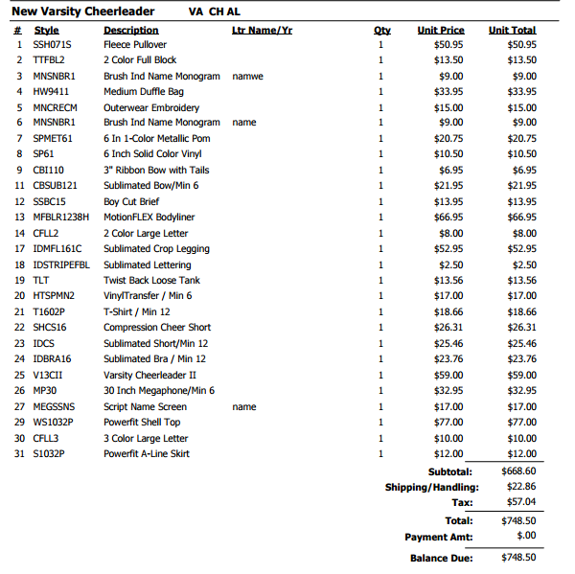

Slide 5
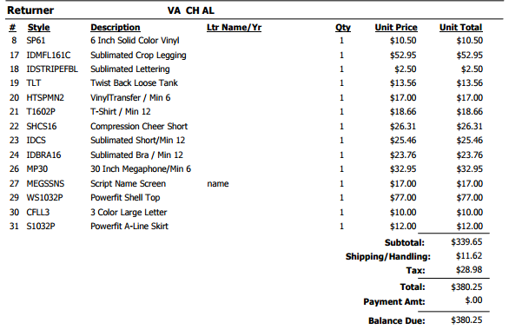
MotionFlex Bodyliner
$447.20

Slide 7
For fitting you need…
Cheer shoes
Any item you want to be “carried over”
FULL UNDERWEAR
Parents will not be in fitting room

Slide 8
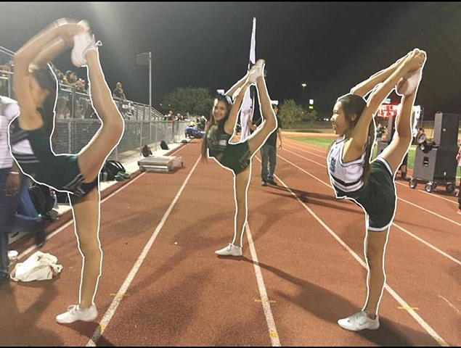
Football Season
Football is our crazy busy season! We cheer every week, have pep rallies almost every other week and our presence is requested at several events.
You need to be prepared!
Practice= non negotiable time

Slide 9
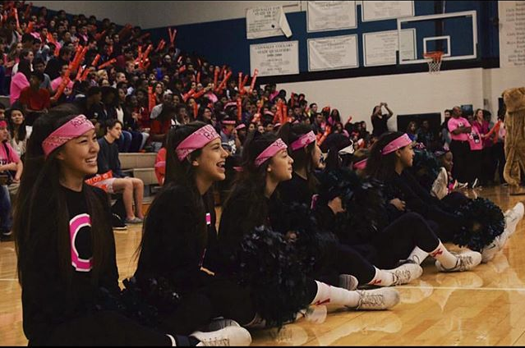
Transportation
JV will cheer at home games only (usually on Thursdays)
Varsity will cheer at every game whether home or away
JV may attend Varsity games under certain conditions
Only a note provided no later than 24 hours in advance will allow you to ride home with friends or family

Slide 10
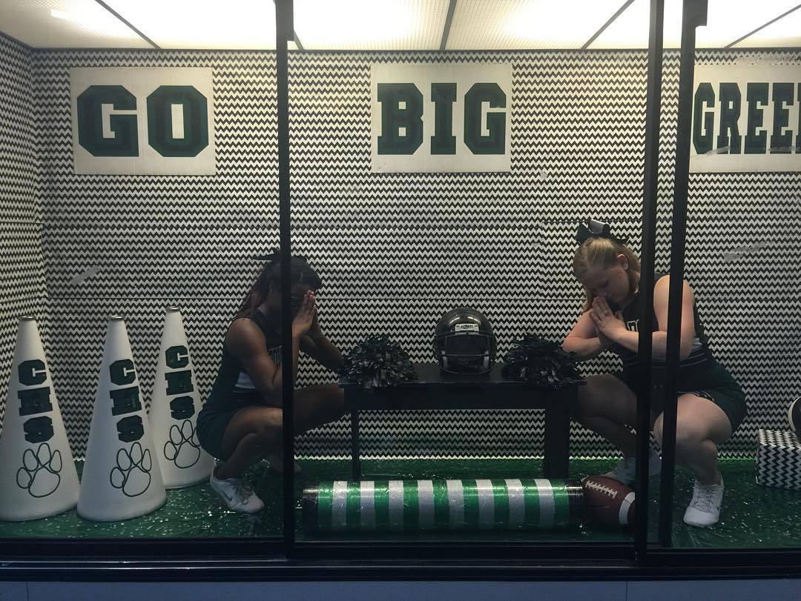
Meals
I am strongly encouraging you to sign up for band booster club meal plan
Nobody will leave

Slide 11
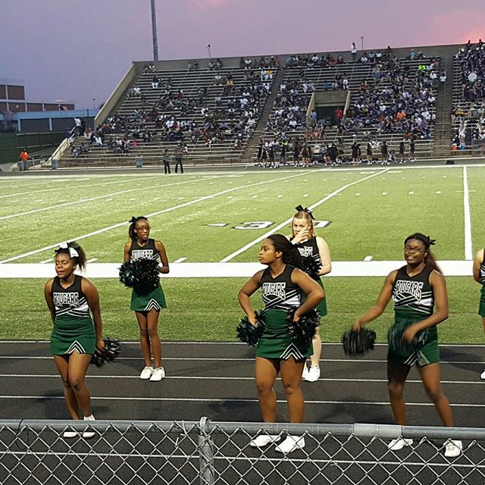
Summer practice
I will have a schedule to you VERY soon
All are mandatory
This is when we choreograph the bulk of our material

Slide 12
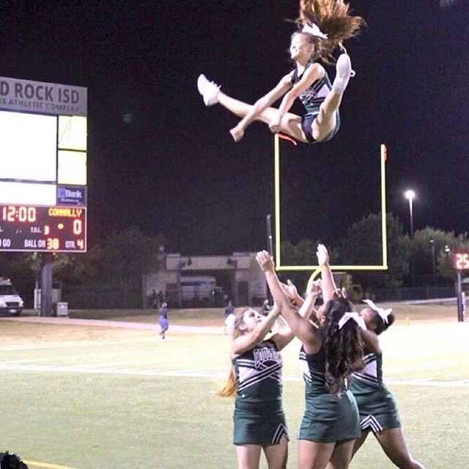
Cheer room
We have one ☺
Keep it clean
It is NOT a locker room
Cannot be used during your off period
For cheer stuff only
Friends and other students are not allowed
Not available during the school day

Slide 13
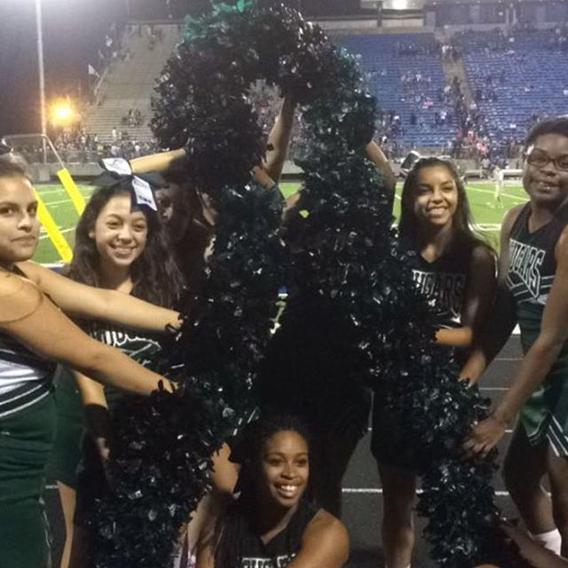
Uniforms
There are two different uniforms..Traditional (JV) and Varsity (white and black)
Varsity will purchase the traditional uniform
Uniforms must have a deposit and release signed and on file
If you don’t have the complete uniform on game day you will not cheer
Friends and Family are not allowed to wear your cheer items

Slide 14
Remind 101, email, My cell
Remind 101 is the easiest way to get in contact with all cheerleaders quickly. Parents do not need to be in it. Text @1617co to 81010 and follow instructions
Demetri.ivy@gmail.com I need everyone's email. I will respond within 24 hours
512-694-4662 my cell. Please use ONLY in emergencies.
Respect my time. I will no longer answer phone calls and texts before 8:30 or after 5:00 unless I am with cheerleaders.
Generic questions go to captains first
Check website for answers to questions before asking captain connallycheer.weebly.com

Slide 15
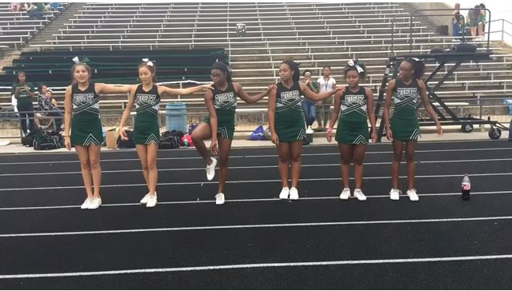
Booster club
Great start from previous year
It has to work
Parents that want to play an active role in supporting cheer need to get with booster club
Booster club is a “separate” organization from cheer. I cannot fix or include my input
Ms. Chapman

Slide 16
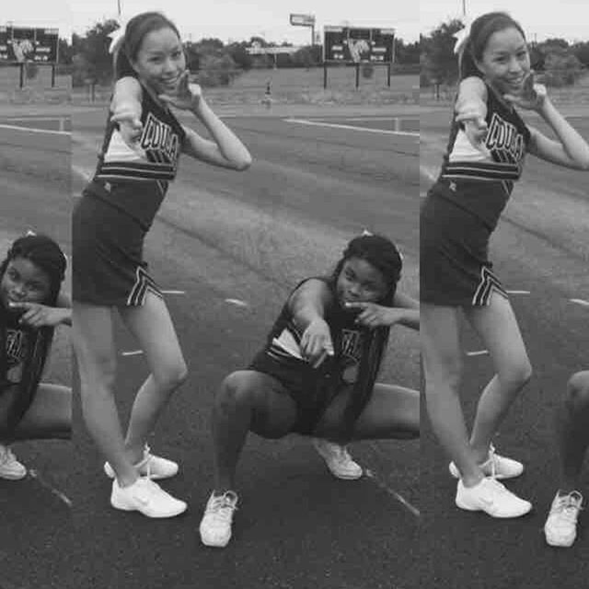
If you have concerns
Cheerleaders
Cheer Coach
Administrator

Slide 17
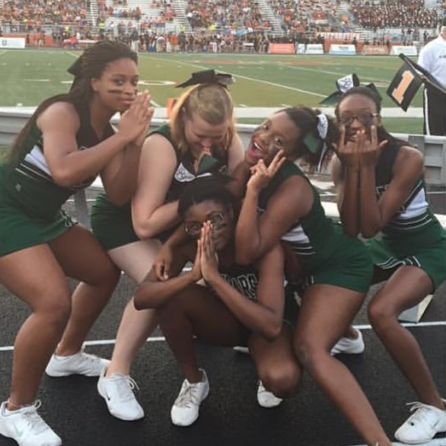
Fundraisers vs sponsorships
We will participate in at least two fundraisers this year
Sponsorships are VERY MUCH easier than fundraisers
Fundraising for camp

Slide 18
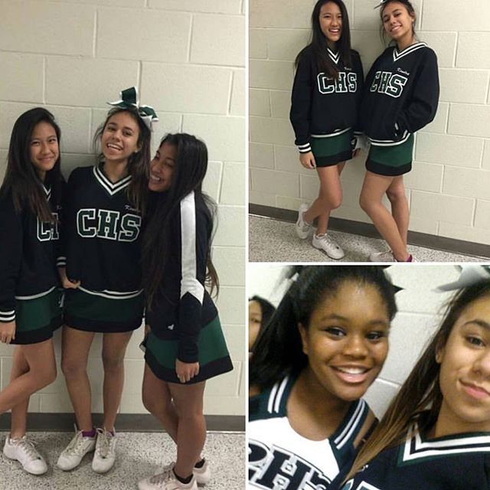
Behavior, grades, leadership
Its non negotiable
ISS means you are out for the day

Slide 19
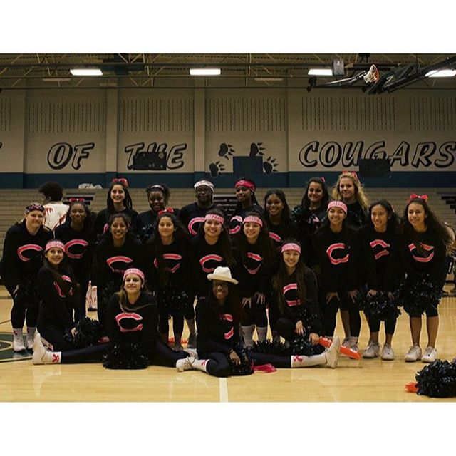
Financial obligations
Everything will be done online
Payment due dates..I cannot move them THEY ARE SET
Get with me if money is an issue but understand that there isn’t much I can do

Slide 20
Camp choices

Slide 21
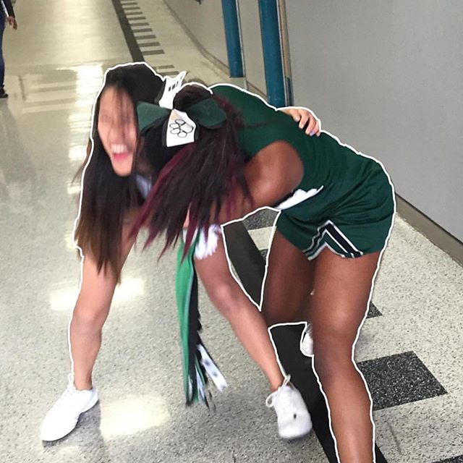
After we sweat…we will celebrate
Work hard..play hard…celebrate even harder!!!!!!!!!

Slide 22
Questions….

